Slide 1
Dynamic Sensitivity Control V2
Date: 2013-11
Authors:

Slide 2
Background
802.11 uses CSMA/CA carrier sense multiple access with collision avoidance.
STA listens before transmitting
Two methods of sensing the medium
Physical Carrier Sense Is there RF energy present?
Virtual Carrier Sense Is there an 802.11 signal present?
Clear Channel Assessment (CCA)
OFDM transmission => minimum modulation and coding rate sensitivity (6Mbps) (-82dBm for 20MHz channel, -79dBm for 40MHz channel)
If no detected header, 20 dB higher, i.e. -62dBm

Slide 3
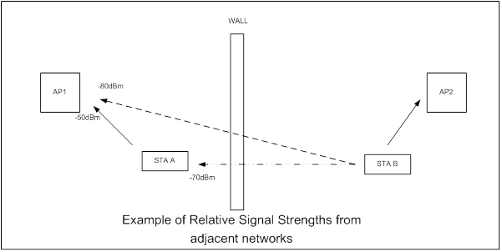
Example – background to idea
AP1 to STA A -50dBm, (also AP2 to STA B)
STA B is 4x as far from AP 1 as STA A.
Therefore AP1 receives STA B at -80dBm (50 + 20* +10 wall) *10dB per octave
STA A receives TX from STA B at -70dBm (50 +10* +10wall)
Note: AP1 receives AP2 <-82dBm so CCA is not exerted
STA A and STA B could both transmit successfully to their APs at the same time
BUT each is prevented by CCA.
CCA was designed for greatest range

Slide 4
Dynamic Sensitivity Control - DSC
Imagine a scheme where STA measures the RSSI of the AP Beacon (R dBm)
Then sets its RX Sensitivity Threshold at (R – M) dBm, where M is the “Margin”
Hence, for example:
STA receives Beacon at -50dBm, with Margin = 20dB STA sets RX Sensitivity Threshold to -70dBm.
Also set an Upper Limit, L, to Beacon RSSI at, say, -30 or -40dBm to cater for case when STA is very close to AP.
Need to ensure that all the STAs in the wanted area do see each other. Hence if one STA very close to AP, then it could set RX Sensitivity too high and we get hidden STAs.

Slide 5
CCA Threshold/RX Sensitivity
L = Upper Limit M = Margin R = Received RSSI
RX Sensitivity, RxS
Reff = MIN (RxS, L)
RxS = (Reff – M)
Example, FOR L = -40dBm and M = 20dB
RSSI, R dBm | Reff | Rx Sensitivity, dBm
-30 | -40 | -60
-40 | -40 | -60
-50 | -50 | -70
-60 | -60 | -80

Slide 6
Apartments
Consider an apartment
Using DSC complete apartment coverage
but overlap is confined mostly to direct neighbors
Only ‘worse case’ STA overlap
Extends into 2nd neighbor

Slide 7
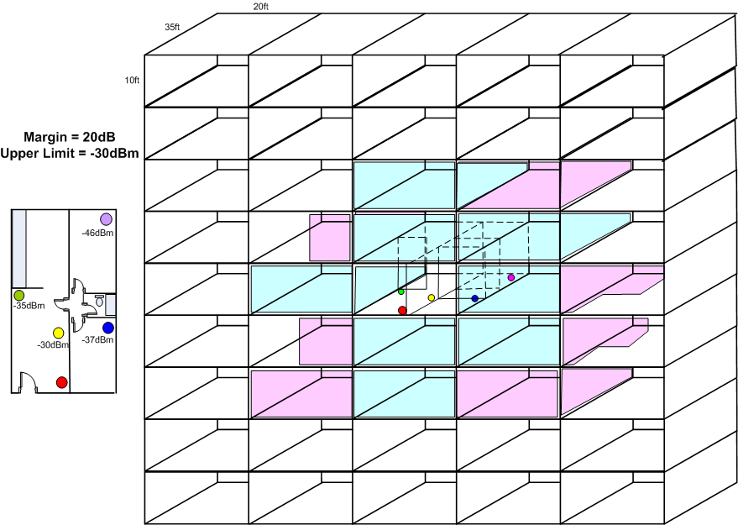
Apartment Block
No DSC
45 Overlapping
With DSC
7 to 8 overlapping
NOTE: Dense apartment block is a priority Use Case

Slide 8
Terrace/Town Houses

Slide 9
Terrace/Town Houses

Slide 10
Terrace/Townhouse
No ‘hidden’ STAs in garden

Slide 11
Enterprise/Hotspots

Slide 12
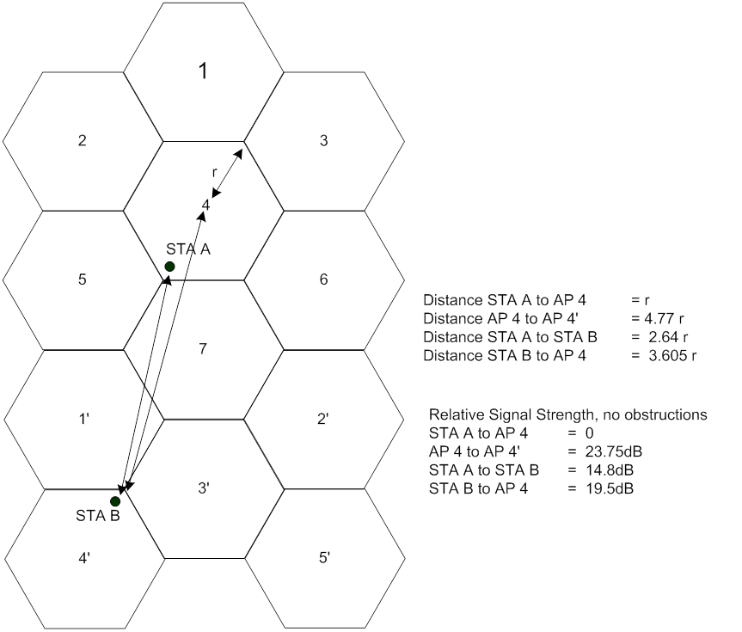
Enterprise and Hotspots
Note if STA A moves, then
it loses the DSC protection and then
it is encouraged to switch channels
as now has lower throughput.
Note that this type of cell cluster is impossible
without TPC or DSC. TPC fails if any one not complying
But also would make TX at highest data rates difficult.
DSC ensures highest data rates used.

Slide 13
Hidden STAs – Fixed CCA/Sensitivity

Slide 14
Hidden STAs – Dynamic CCA/Sensitivity

Slide 15
NO HIDDEN STAs
Parameters can be adjusted to suit conditions and desired coverage

Slide 16
Coverage and Capacity - Conventional

Slide 17
Coverage and Capacity - DSC

Slide 18
Capacity Estimate for Fixed vs DSC CCA
Assume 11n 2SS, 16K aggregation
117Mbps throughput is 81.2Mbps max (74.5Mbps with RTS/CTS)
52Mbps throughput is 39.7Mbps max (37.7Mbps with RTS/CTS)
Fixed CCA
19/37 cells @ 117Mbps and 18/37 cells at 52Mbps
Throughput is 19/37*74.5 + 18.37*37.7 = 56.6Mbps
Assume 7 APs on different channels covering the area
Throughput over total 37 cells is 396.5Mbps (56.6 x 7)
DSC
All traffic at 117Mbs,
Throughput over 37 cells is 3004.8Mbps (81.2 x 37)
An improvement of 7.58 in capacity

Slide 19
Setting the Margin
The Margin needs to be set :
Large enough to provide adequate SNR
A STA at edge of CCA transmits at same time. The Margin is the worse possible effective SNR (from a single simultaneous TX).
Large enough to account for sudden changes in reception of Beacon signal
If STA goes behind obstruction, RSSI will drop. If the drop is higher than the Margin, then the AP Beacon is lost.
Suggested Margin is in the order of 20dB to 25dB.
See slide on Algorithm for setting Threshold

Slide 20
Flexibility
Upper Limit and Margin can be adjusted to suit the application for an optimum result (AP can control)
20dB Margin suggested as 20dB is approx required SNR for higher data rates
AP then sets its own Sensitivity or CCA
Based upon the Margin and Upper Limit

Slide 21
Algorithm for setting CCA/RX sensitivity
The Beacon RSSI will vary as the STA moves, for example. Therefore, the calculation of the CCA threshold or Receive Sensitivity is a continuous one.
A suggested algorithm outline is:
Start a timer T
Record RSSI of each Beacon
Check if > Upper Limit, if so RSSI = Upper Limit
Calculate average RSSI
Use a moving average such that last reading has higher influence
Check if T > Update period (e.g. 1 second)
No, continue, get next beacon
Yes, Convert the Averaged RSSI to CCA Threshold (or RX Sensitivity)
CCA Threshold = Ave RSSI – Margin.
Back to 1
In addition, check if a Beacon or consecutive Beacons are missed, and if so decrement the average RSSI by a set amount
Hence, every 1 second the CCA Threshold is reset, (reset immediately if beacon(s) missed.)

Slide 22
Summation of interference Worse case analysis
There could be 6 other STAs,
on same channel,
TX at same time.
This is 7.8dB addition.
Resultant SNR still > 23dB

Slide 23
AP Considerations
AP can set the Upper Limit and Margin parameters for STAs
Advertises settings (similar to EDCA parameters)
AP bases its own CCA on the DSC parameters it advertises
Based upon advertised settings
Based upon desired coverage
AP can issue “No DSC” to be used
For large area coverage outdoors, for example.
AP could learn OBSS situation while simply listening to Beacons from other network(s). Set Upper Limit accordingly.
Part of Channel Selection process (as per 11aa)
Sets Upper Limit so that OBSS is mitigated
Could be dynamic with periodic scans
All could be covered in 802.11 Standard now
(increase 11n throughput by >7 times)
Directly applicable to HEW SG as it improves the effective throughput in an area

Slide 24
Additions to the Standard
DSC Parameter Set Element
The DSC Parameter Set element provides information needed by STAs for operation of dynamic sensitivity control that is used to control the thresholds for CCA
 | Element ID | Length | DSC Margin | DSC Upper Limit
octets | 1 | 1 | 1 | 1

Slide 25
Legacy STAs – No problem if in separate network
In each of the cases considered, Apartments, Houses, Cell Cluster, the legacy STA is UNAFFECTED
If the Legacy STA is in a separate network,
If STA does not use DSC then:
If already started to TX it will complete (DSC STA can TX at same time)
If Legacy STA not started to TX it will hold off with CCA in the normal fashion if DSC STA is TX – no difference
DSC simply allows the STA using it to TX at the same time.
Legacy network performance improves as need not wait so long for DSC network to TX (simultaneous TX)

Slide 26
Legacy STA – Same Network
If any STA is outside the coverage area set by the DSC, then it is at a disadvantage as its TX could be stepped on by the DSC STA that is close to the AP. This is the same situation as “hidden STA”.
“Hidden STA” situation exists now so nothing new
Number of “Hidden STAs” reduced by DSC
Note examples, possibility of hidden legacy or DSC STA is remote.
Consider also need to keep high data rates hence want to restrict range. (Especially if using 40MHz channels or higher).
Finally
If outdoor and large area coverage required, DSC could be disabled by AP IE.
Finally, Finally
There is a huge encouragement to enact DSC, unlike TPC.

Slide 27
Conclusions
In the examples studied:
DSC has a significant impact on area throughput
Frequency reuse is increased by a significant factor
In cell cluster example, 2SS 20MHz BW total area throughput is increased from 396.5Mbps to 3004.8Mbps (7 APs vs 37 APs)!
DSC reduces or eliminates chance of hidden STAs
Legacy STAs are not disadvantaged
DSC is easy to implement and does not require every network to comply, (as does TPC).

Slide 28
Discussion
We can expand the examples to specific enterprise, office environments.
Network coverage is NOT simple circles. It is bounded by walls, floors, obstructions such that the propagation is not dB linear it suffers from jumps, e.g. 10dB per outside wall, 3 – 6dB inside walls.
Network coverage can be made ‘cell like’ so as to improve the overall coverage.
If only one network uses DSC it does not impact performance on other network – in fact it lessens impact as now TX simultaneously so other network does not need to wait so long.
DSC Limit can be set to cover desired network area.
Correct choice of Upper Limit and Margin
DSC can be combined with channel selection and mitigate OBSS.
DSC can improve overall Wi-Fi throughput in an area.
AP can control settings – see next slide

Slide 29
Straw Polls
Do you think that DSC merits consideration for existing PHYs?
Yes
No
Do you think that DSC merits consideration for HEW?
Yes
No

