Slide 1
Dedicated Short Range Communication (DSRC) Applications Tutorial
Date: 2013-05-14
Authors:

Slide 2
Abstract
This presentation provides information about Dedicated Short Range Communication (DSRC), which uses IEEE 802.11p in the 5.9 GHz band in the US and Europe. The primary purpose of the presentation is to illustrate many vehicle-to-vehicle and vehicle-to/from-infrastructure use cases for DSRC

Slide 3
Agenda
DSRC Mission, Purpose & Safety Benefits
How Does it Work?
Application Use Cases
  Safety Applications – V2V and V2I
  Commercial Vehicle Applications - V2V and V2I
  Private Applications
DSRC 5.9 GHz band use
Proposed U-NII-4 Overlay on DSRC 5.9 GHz
DSRC Channel Requirements – NTIA 5 GHz Report

Slide 4
DSRC Mission and Purpose
DSRC: A short to medium range ITS communications service that supports both Public Safety and Private operations in roadside to vehicle and vehicle to vehicle communication modes.
Vehicle communication to/from proximate device
  Vehicle to Vehicle (V2V) – Broadcast only.
  Vehicle to Roadside Infrastructure (V2I), generally broadcast with some two-way transactions.
Benefits of Safety Applications:
  Collision Avoidance
  Improved Mobility
  Improved Environmental

Slide 5
V2V and V2I Safety Benefits
US Crash Statistics (2011)
  > 5 Million crashes
  > 30,000 traffic fatalities
  > 2 Million injuries
Accidents have huge costs:
  Loss of life & Injuries
  Property damage
  Lost productivity
  Health care and emergency services
DSRC communication can “reduce, mitigate, or prevent 80% of crashes by unimpaired drivers” – US DOT
AAA estimates aggregate cost of accidents at $300 Billion

Slide 6
How does it work? V2V
Each vehicle broadcasts its core state information in a “Basic Safety Message” (BSM) nominally 10 times/sec.
BSM is sent in 360º pattern using IEEE 802.11p technology.
Upon receipt of BSM, vehicle safety host builds model of each neighbor’s trajectory, assesses threat to host vehicle, warns driver (or takes control) if threat becomes acute.

Slide 7
How does it work? V2I
Two intersection RSE messages enable a suite of intersection-related safety applications.
  SPaT message - Signal Phase and Timing
  MAP message – Intersection geometry
Other RSEs can send Traveler Information message on curve speed, height restriction, icy roads, etc.
IP data exchange with servers in the Internet – RSE acts as forwarder

Slide 8
Safety Applications – V2V
Forward Collision Avoidance FCA
Emergency Electronic Brake Lights EEBL
Blind Spot Warning BSW
Lane Change Assist LCA
Do Not Pass Warning DNPW
Intersection Collision Warning ICA
Wrong Way Driver Warning WWDW
Cooperative Adaptive Cruise Control CACC
Examples Follow:

Slide 9
V2V Safety Use Case
Forward Collision Warning (FCW)
DSRC communication
Stopped Car
Approaching Car
If driver of approaching car does not stop, or slow appropriately, warning issued within car.

Slide 10
V2V Safety Use Case
Emergency Electronic Brake Lights (EEBL)
Traffic
Jam
High deceleration by car approaching jam. Trailing car Informed via DSRC within 100 msec.

Slide 11


V2V Safety Use Case
Blind Spot Warning (BSW)
Driver receives warning when showing intent to change lanes
Normal driving – advisory indicator of car in blind spot
Note: Specific timing, format, or decision logic for advisories and warnings will likely vary for each car manufacturer

Slide 12
V2V Safety Use Case
Do Not Pass Warning (DNPW)
Oncoming
traffic
When showing intent to move to oncoming lane, driver receives warning if not safe to pass.

Slide 13
V2V Safety Use Case
Intersection Collision Warning (ICA)
Building: Leads to Non-Line Of Sight (NLOS) communication
If intersecting trajectories are indicated,
driver is warned.

Slide 14
Safety Applications – V2I
Applications enabled by SPaT:
  Red Light Running RLR
  Left Turn Assist LTA
  Right Turn Assist RTA
  Pedestrian Signal Assist PED-SIG
Applications enabled by Signal Request Message
(bi-directional communication):
  Emergency Vehicle Preempt PREEMPT
  Transit Signal Priority TSP
  Freight Signal Priority FSP
Rail Crossing RCA
Examples follow:

Slide 15
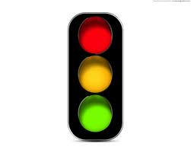
Safety Use Cases: SPaT and MAP
Messages sent from RSE:
Signal Phase and Timing (SPaT) - dynamic
MAP (intersection geometric description) - static
RSE may also send GPS Correction Data
Vehicle Without DSRC
Application Types:
  RLR
  LTA
  RTA
  TSP
  FSP
  PED-SIG
SPaT can also enable non-safety applications like “Green Wave”
Transit Vehicle
Freight Yard

Slide 16

Safety Use Case: Work Zone Warning
May 2013
WORK
In-Vehicle Display
and Annunciation
ZONE
AHEAD
Grass Divider
Work Zone
Work Zone Warning Com. Zone
Traffic Cones
RSU
up to 1100 ft range

Slide 17



V2I Safety Use Case: Road Hazard Warning
Up to 650 ft forward of the Hazard
90 m (300 ft) range
Dynamic Message Sign and Multi-App RSU
Road Condition Warning Com. Zone
ICE
Road Sensor Station
Bridge
Median
Variations include:
Road Condition (ice), Curve Speed
Low Bridge Roll-over
Roadway Weather (RWIS) In Vehicle Signage
Accident Ahead Rock slide, etc.

Slide 18
V2I Safety Use Case: (PREEMPT)
(also used for Transit/Freight Priority)
May 2013
Emergency Vehicle
~
~
OBE
RSE
~
~
DSRC Transaction occurs on Ch. 184 at high power.
~
~
up to 1000 m (3281 ft)
Preempt Transaction
1. DSRC OBE-to-RSE: Vehicle Host Preemption Request
2. DSRC RSE-to-OBE: ACK
3. Emergency Vehicle Host Displays Preempt-ACK within vehicle

Slide 19
V2I Safety Use Case: Standardized Tolls
May 2013
RSE-Equipped
Gantry
Capture Zone
30 m
(98 ft)
Open Road Example

Slide 20
V2I Safety Use Case: RR Grade Crossing
Train 20-40 sec. distant
Train 20-40 sec. distant
Conventional
RR Grade Crossing Equipped with RSE
RSE warning range increased compared to conventional equipment
Can also be used at non-signalized crossings
Range up to 1100 ft
RR Warning Sign

Slide 21
Commercial Vehicle Applications –
V2V and V2I
CVO Significant Benefit from Safety Applications
Plus Other CVO Centric Applications:
  Border Crossing
  Control Loss Warning
  Driver Log
  Fleet Management
  Freight, Inventory & Container Management
  Wireless Inspection
  Vehicle Diagnostics
  Weigh in Motion (WIM) Stations

Slide 22
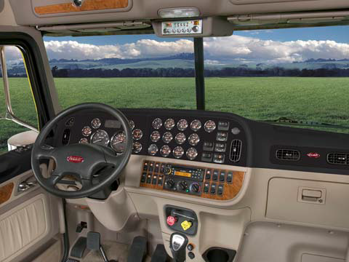
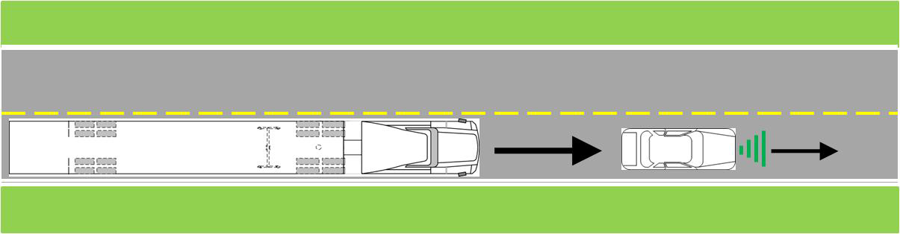
CVO Applications – V2V and V2I
Unique to CVO Driver & Vehicle
Vehicle Size
Cab Environment
Workload
Duration

Slide 23
Private Applications – V2I
  All Vehicles Benefit from Safety Applications
  Many CVO Applications
Plus Other Private Apps
  Access Control
  Probe Data / Traffic Information
  Advanced TIS
  Fuel / Drive-thru Management
  Parking Management
  Rental Car Transactions
  Service Record
  Vehicle Diagnostics (Service Engine Soon)

Slide 24
Private Applications Use Cases – V2I
Gas Pumps
Service Area
GARAGE
Single Family House
Transit Vehicle
Fueling Management
Access Exit Control
Data upload/download
Service Records: Bulletins, Recalls, Routine & Preventative Maintenance
SERVICE BAYS
Parking Management & Payment
Service Management

Slide 25
V2I Safety Use Case: RSE Urban Deployment
Comm. Zones
5th Street
4th Street
3rd Street
2nd Street
1st Street
up to 1000 ft
Main Street
Overlapped Coverage Zones Require Multiple DSRC Channels

Slide 26
DSRC Spectrum (Channel 172)
FCC designated “exclusively for vehicle-to-vehicle safety communications for accident avoidance and mitigation, and safety of life and property applications”
Extensive industry research, testing, and field trials of safety applications using Ch. 172
Will host 3 message types:
  Basic Safety Message (V2V)
  MAP Message (V2I)
  Signal Phase and Timing Message (V2I)
Nominal transmit power +20 dBm with 0 dBi antenna

Slide 27
DSRC Spectrum (Channel 184)
FCC designated “exclusively for high-power, longer-distance communications to be used for public safety applications involving safety of life and property, including road intersection collision mitigation”
Road authorities and public agencies primarily responsible for usage
Max. power 40 dBm

Slide 28
DSRC Spectrum (Channel 178 & Other)
Ch. 172:
Collision Avoidance Safety
Ch. 184: Public Safety
Ch. 178:
Control Channel
WAVE Service Advertisements are broadcast here, indicating how to access services on other “Service Channels”

Slide 29
DSRC and U-NII-4 Devices in 5.9 GHz Band
DSRC
U-NII-4
U-NII-4
U-NII-4
U-NII-4

Slide 30
DSRC Applications – Channel Requirements
DSRC includes safety of life service
DSRC packet latency and dependable delivery critical for collision avoidance apps
DSRC requires multiple channels to support:
  V2V Collision Avoidance
  V2I Collision Avoidance (e.g., SPaT)
  Work Zone, Road Hazards, and Preempt
  Tolls
  Traveler Information
  Commercial Vehicle Operation (CVO)
  Private Use
  Service Advertisements
  Interference mitigation from other RSE in close proximity

Slide 31
NTIA 5 GHz Report
  NPRM FCC 13-22 includes NTIA 5 GHz Report by reference
Regarding DSRC:
  DSRC is incumbent in 5.9 GHz band
  NTIA treats DSRC service similarly to Federal systems
  Federal agencies (implying DSRC) will not alter their systems
  DFS anticipated as required for U-NII-4 devices (802.11ac and other)
  DFS schemes for RADAR not suitable for detection of DSRC
NTIA Initial Conclusions:
  Existing U-NII regulations not developed to detect DSRC signals
  U-NII detection may not be capable of detecting DSRC
  Changes to DFS detection parameters may (still) not protect DSRC from ‘serious performance degradation.’
  Current U-NII regulations not designed for non-co-located Tx and Rx

Slide 32
Future of DSRC
National Highway Transportation Safety Administration (NHTSA) regulates vehicles in US
NHTSA is evaluating efficacy of DSRC-based collision avoidance systems
NHTSA will announce later in 2013 whether they plan to begin a process to require DSRC devices in new cars
  Will make similar evaluation in 2014 with regard to heavy trucks
Several suppliers of aftermarket DSRC devices are also exploring this market

Slide 33
Concluding Remarks
With DSRC the “Connected Vehicle” holds the promise of:
  Saving lives and reducing property loss
  Improving transportation efficiency
  Improving the environment
  Opening a new frontier for innovation
Will be used wherever vehicles go
  EU and Japan also planning implementations
V2V Designed to operate solo
  E.g. adaptive congestion control based on channel load
Band Sharing presents significant challenges

Slide 34
Thank You!
John Kenney
Toyota InfoTechnology Center, USA
jkenney@us.toyota-itc.com

