Slide 1
TGah Efficient TIM Encoding
Date: 2012-05-14
Authors:

Slide 2
Authors:

Slide 3
Introduction
TIM element in STD 802.11 - 2012
Supports up to 2007 STAs (2008 AIDs)
Contains the entire traffic indication bitmap
Inefficient to encode a low density bitmap
802.11ah requirements
Need to support more than 2007 STAs (e.g. 6000 STAs) [1]
Need to support two very different use cases [2]
Sensor use case: low duty-cycle, Extended Wi-Fi use case: high duty-cycle
One beacon interval can support only limited number of STAs (e.g. < 100 STAs)
Low density bitmap for a large number of associated STAs
TIM has to be encoded efficiently to minimize channel occupancy (overhead)
TGah data rates are much lower than 802.11a/b/g/n/ac
In this presentation, an efficient TIM encoding scheme is proposed

Slide 4
Current 802.11 STD Partial Virtual Bitmap Encoding - Example
802.11 STD Partial Virtual Bitmap Encoding
“… the Partial Virtual Bitmap field consists of octets numbered N1 to N2 of the traffic indication virtual bitmap, where N1 is the largest even number such that bits numbered 1 to (N1 × 8) – 1 in the bitmap are all 0 and N2 is the smallest number such that bits numbered (N2 + 1) × 8 to 2007 in the bitmap are all 0.
Example:
AID=6, AID=20, AID=45, AID=108, and AID = 1010 bits set to 1
5 AIDs are encoded into 127 bytes Partial Virtual Bitmap
Current TIM encoding is inefficient for a low density bitmap*.
*) Bitmap density = number of paged stations/number of associated stations
Traffic
Indication
Bitmap
(total 251 Bytes)
Encoded Partial Virtual Bitmap
= 127 bytes

Slide 5
Proposed Hierarchical Structure of Traffic Indication Map
Basic idea:
Divide the total AID space into small blocks in a hierarchical manner and transmit only the blocks with non-zero values
Easier to break a large TIM into small groups of STAs and easier to maintain
Different classes of STAs can be easily grouped into different groups/pages (e.g. Sensor STAs in Page 1 and Offloading STAs in Page 2)
Three level hierarchy: Page/Block/Sub-Block
Supporting max TBD STAs (e.g. 8192)
N_{P} (e.g. 4) Pages:
Page 1
Page 2
Page 3
Page 4
2048 STAs
N_{B} (e.g. 32) Blocks:
Block1
Block2
Block3
Block4
Block5
Block6
Block7
Block8
…
Block31
Block32
64 STAs
8 Sub-blocks:
1 octet
= 8 STAs

Slide 6
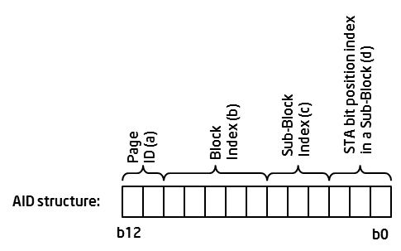
AID Structure
Based on the hierarchical structure of the traffic bitmap in the previous slide, the association identifier (AID) structure is maintained as below
STAs are grouped into Pages, Blocks, Sub-Blocks
The number of Pages and Blocks are variable

Slide 7
TIM Encoding Propsal - Block level encoding
Partial Virtual Bitmap is encoded in Block level
Partial virtual bitmap consists of one or more encoded Blocks of a single Page
Block encoding:
Block Control(3 bits) + Block Offset (5 bits) + Block Bitmap (1octet) + Sub-Block Bitmaps (0-8octets)
Block Control field: controls how the Block Bitmap and the Sub-Block Bitmap fields are used
Block bitmap encoding: AID = [Page Index(2b), Block Offset(5b), n(3b), m(3b)]
The n-th bit position of the Block Bitmap indicates whether the n-th Sub-Block Bitmap is present in the Sub-Block field
The m-th bit position of the Sub-Block Bitmap indicates whether the m-th STA has data buffered at the AP
Single AID: AID = [Page Index(2b), Block Offset(5b), Block Bitmap[5:0]]
When there is a single AID in a Block, 6 bits of the Block Bitmap field is used to indicate the 6 LSBs of the AID
The Sub-Block field is not present
Inverse bitmap: if there are many 1s in the bitmap of a Block, inverse the bitmap and encode the inversed bitmap
Can expect many cases where STAs sleep for a long period of time
Bitmap Control
Partial Virtual Bitmap
Block L
Block M
…
Block P
Block Control field:
Block Bitmap
Single AID
‘Offset+Length+Bitmap’
+
Inverse bitmap
Bitmap Control (1 octet)
1 octet
1 octet
0-8 octets
TBD
Page
Index
Block
Control
Block Offset
Block Bitmap
Sub-Blocks (variable)
2 bits
3 bits
5 bits
1 octet
Sub-Block
Bitmap 1
Sub-Block
Bitmap 2
…
Sub-Block
Bitmap M

Slide 8
Offset+Length+Bitmap (OLB)
‘Offset+Length+Bitmap’ mode: encodes more than 8 Sub-Block Bitmaps.
The Block Bitmap field is used to indicate the length of Sub-Block Bitmaps following the Block Bitmap field.
AID = [Page Index (2b), Block Offset(5b),zeros(6b)]+ p, the p-th bit position of the Sub-Block Bitmap field indicates whether the p-th STA has data buffered at the AP.
This mode is used when more than 8 contiguous Sub-Blocks are transmitted.
Bitmap Control
Partial Virtual Bitmap
Block n
Block n+1
…
Block n+m
Block p
…
Block v
Bitmap Control (1 octet)
2 octets
L octets
OLB mode
TBD
Page
Index
Block
Control
Block Offset
Length (L)
L Sub-Block Bitmaps
2 bits
3 bits
5 bits
1 octet

Slide 9
1. Block Bitmap mode
Block Bitmap encoding
Block offset(5b) + Block ctrl(3b) + Block bitmap(1 octet) + Sub-block bitmap (0-8 octets)
Example bitmap:
Total encoded length = 5 bytes
Block 1
Sub-block1
Sub-block3
Sub-block7
Traffic indication bitmap:
0010 1001
0000 0000
1001 0001
0000 0000
0000 0000
0000 0000
0001 0000
0000 0000
Block
Ctrl (3b)
Block
offset
Block
bitmap
AID=51 ( 00 00000 110 011)
Block Bitmap
00000
1010 0010
0010 1001
1001 0001
0001 0000
Encoded bitmap
Sub-block
Bitmap 1
Sub-block
Bitmap 3
Sub-block
Bitmap 7
n-th bit position indicates presence of n-th Sub-block

Slide 10
2. Single AID mode
Single AID mode
Block offset (5b) + Block ctrl(3b) + last 6 bits of an AID
Example bitmap:
Encoded bitmap:
Total encoded length = 2 bytes
Block 1
Sub-block1
Sub-block3
Sub-block7
Traffic indication bitmap:
0000 0000
0000 0000
0000 0000
0000 0000
0000 0000
0000 0000
0001 0000
0000 0000
AID=51 ( 00 00000 110 011)
Block
Ctrl (3b)
Block
Offset (5b)
Block
bitmap
6 LSBs of the AID
Single AID mode
00000
110011 00
6 LSBs of the AID

Slide 11
3. Inverse Bitmap mode
Block bitmap + Inverse mode
Block offset(5b) + Block ctrl(3b) + Block bitmap(1 octet) + Sub-block bitmaps (0-8 octets)
Example bitmap:
Total encoded length = 4 bytes
Decoding is simply the reverse procedure of the encoding
Sub-block1
Block 1
Sub-block7
Traffic indication bitmap:
0010 1001
1111 1111
1111 1111
1111 1111
1111 1111
1111 1111
0001 1111
1111 1111
Inverse the bitmap
1101 0110
0000 0000
0000 0000
0000 0000
0000 0000
0000 0000
1110 0000
0000 0000
Block
Ctrl (3bits)
Block
Offset(5b)
Block
Bitmap
Block Bitmap +Inverse
00000
1000 0010
1101 0110
1110 0000
Encoded bitmap
Sub-block
Bitmap 1
Sub-block
Bitmap 7
n-th bit position indicates presence of n-th Sub-block

Slide 12
4. OLB mode
Offset+Length+Bitmap mode
Block offset(5b) + Block ctrl(3b) + Length(8b) + Sub-block Bitmaps
Total encoded length = 16 bytes
Traffic indication
bitmap:
Sub-block1
Sub-block8
Block#0
0010 1001
0100 1010
1001 0001
0110 1001
1010 1011
0111 0101
0001 0000
0010 0001
Block#1
1001 0001
0001 0000
0010 0001
0001 0000
0010 0001
1010 1011
0000 0000
0000 0000
Block
Ctrl (3bits)
Block
offset
Block
bitmap
Encoded bitmap
Offset+Length +Bitmap mode
00000
Length=14
0010 1001
0100 1010
1001 0001
0110 1001
1010 1011
0111 0101
0001 0000
0010 0001
Indicates the length of the Sub-Block bitmaps
1001 0001
0001 0000
0010 0001
0001 0000
0010 0001
1010 1011

Slide 13
Compression Comparison (1)
Scenario 1: 126 STAs
126 STAs associated with AP
X axis indicates the number of paged STAs
randomly distributed AIDs in [1:126]
Averaged over 200 iterations
Y axis represents the size of the compressed bitmap
Curves
Hierarchy: Block level compression with inverse encoding
Hierarchy + OLB: Block level compression with ‘Offset + Bitmap + Length’ mode (indicated as ‘Adaptive’ in Y-axis)
STD-VTIM: Standard virtual TIM map
Including OLB mode helps reduce TIM length in mid-density region of the map by up to 10%.
Compression performance of Hierarchy+OLB is the best in all TIM map densities

Slide 14
Compression Comparison (2)
Scenario 1: 256 STAs
256 STAs associated with AP
X axis indicates the number of paged STAs
randomly distributed AIDs in [1:256]
Averaged over 200 iterations
Y axis represents the size of the compressed bitmap
Curves
Hierarchy: Block level compression with inverse encoding
Hierarchy + OLB: Block level compression with ‘Offset + Bitmap + Length’ mode (indicated as ‘Adaptive’ in Y-axis).
STD-VTIM: Standard virtual TIM map
Including OLB mode helps reduce TIM length in mid-density region of the map by more than 14%.
Compression performance of Hierarchy+OLB is the best in all TIM map densities

Slide 15
Compression Comparison (3)
Scenario 1: 512 STAs
512 STAs associated with AP
X axis indicates the number of paged STAs
randomly distributed AIDs in [1:512]
Averaged over 200 iterations
Y axis represents the size of the compressed bitmap
Curves
Hierarchy: Block level compression with inverse encoding
Hierarchy + OLB: Block level compression with ‘Offset + Bitmap + Length’ mode (indicated as ‘Adaptive’ in Y-axis)
STD-VTIM: Standard virtual TIM map
Including OLB mode helps reduce TIM length in mid-density region of the map by more than 16%.
Compression performance of Hierarchy+OLB is the best in all TIM map densities

Slide 16
Compression Comparison (4)
Scenario 1: 1024 STAs
1024 STAs associated with AP
X axis indicates the number of paged STAs
randomly distributed AIDs in [1:1024]
Averaged over 200 iterations
Y axis represents the size of the compressed bitmap
Curves
Hierarchy: Block level compression with inverse encoding
Hierarchy + OLB: Block level compression with ‘Offset + Bitmap + Length’ mode (indicated as ‘Adaptive’ in Y-axis)
STD-VTIM: Standard virtual TIM map
Including OLB mode helps reduce TIM length in mid-density region of the map by more than 18%.
Compression performance of Hierarchy+OLB is the best in all TIM map densities

Slide 17
Summary
We proposed
Hierarchical structure of TIM and AID structure
Good for grouping and maintaining different types of STAs
Good for dividing a large size bitmap into smaller size TIM elements
Block level TIM encoding
Good encoding for a wide range of number of STAs
Good for realistic scenarios where limited number of STAs are paged in a single TIM (i.e. the number of paged STAs < 100)
Up to 30-98% smaller encoded bitmap size compared to the current 802.11 STD for the realistic scenarios
Compression performance of Hierarchy+OLB is the best in all TIM map densities

Slide 18
Straw Poll 1
Do you support the hierarchical structure of the traffic indication map shown in Slide 5 and the AID structure shown in Slide 6?
Y:
N:
A:

Slide 19
Straw Poll 2
Do you support the Block-level TIM encoding outlined in Slide 7-8?
Y:
N:
A:

Slide 20
Motion 1
Move to accept the hierarchical structure of the traffic indication map shown in Slide 5 and the AID structure shown in Slide 6 in the TGah Specification Framework document.
Y:
N:
A:

Slide 21
Motion 2
Move to accept the Block-level TIM encoding outlined in Slide 7-8 in the TGah Specification Framework document.
Y:
N:
A:

Slide 22
References
[1] 11/11-905r3 “TGah Functional Requirements and Evaluation Methodology.”
[2] Rolf de Vegt, “Potential Compromise for 802.11ah Use Case Document,” 11-11/457r0.

Slide 23
Backup

Slide 24
Variable Number of Pages and Blocks
The number of Pages and the number of Blocks depend on how the 7 MSBs of an AID is interpreted
64
STAs
…
Blocks:
1
8
9
16
17
24
25
32
4x32
4 Blocks / Page (32 Pages in total)
8 Blocks / Page (16 Pages in total)
16 Blocks / Page (8 Pages in total)
32 Blocks / Page (4 Pages in total)

Slide 25
Grouping
STAs supporting different use cases can be easily grouped into different Pages
Example:
Sensor stations → Page 1
A large number of STAs, infrequent down-link traffic
Offloading stations → Page 2
A small number of STAs, frequent down-link traffic
DTIM Beacon
(Page1,Page2)
TIM Beacon
(Page2)
TIM Beacon
(Page2)
DTIM Beacon
(Page1,Page2)
TIM Beacon
(Page2)
TIM Beacon
(Page2)

Slide 26
Simulation Setup
Parameters:
N_{asta} STAs associated with an AP
N_{asta} = 64, 256, 512,1024, 2048, and 8192
X-axis indicates the number of paged STAs (N_{psta})
The paged STAs randomly distributed in the bitmap [1:N_{asta}]
Averaged over 500 iterations
Y-axis represents the size of the encoded bitmap in bits
Performance comparison
STD-VTIM: the current 802.11 standard virtual TIM encoding scheme including 2 byte offset
Proposed: the proposed Block encoding scheme with Inverse bitmap mode applied

Slide 27
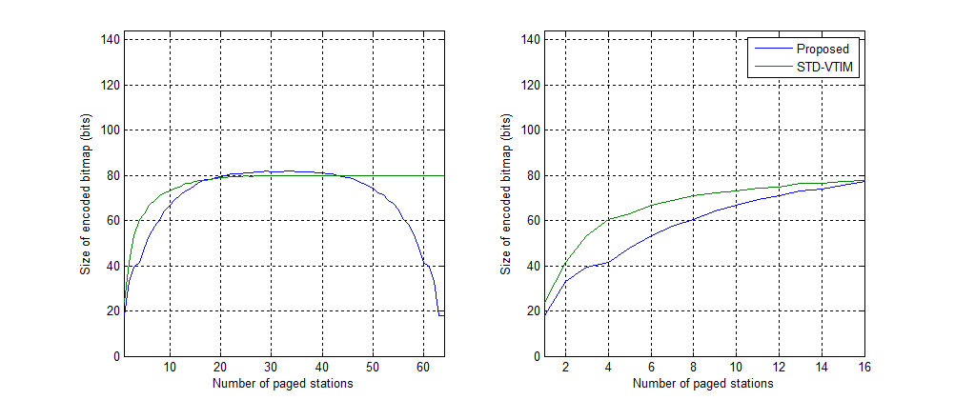
Results - Scenario 1
N_{asta} = 64
The proposed encoding is better than or very close to STD-VTIM
Up to 30% better encoding (Npsta<20, bitmap density < 30%)
Up to 78% better encoding (Npsta>45, bitmap density > 70%)

Slide 28
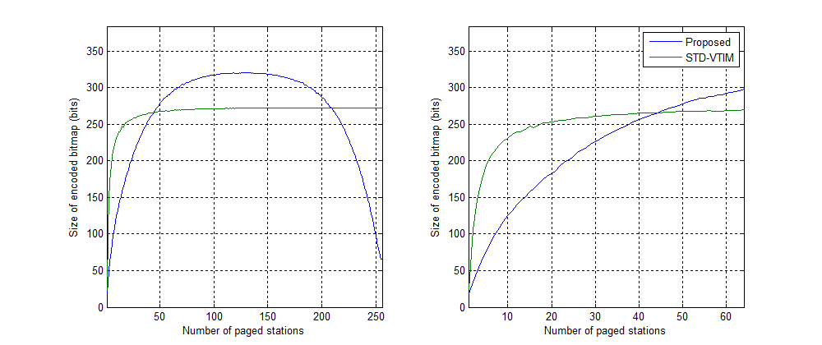
Results - Scenario 2
Nasta = 256
The proposed encoding is better for Npsta <45 (bitmap density < 18%)
Up to 68% better encoding (Npsta<45)
Not likely to have a large number of STAs (e.g. > 100 STAs) be paged in a single TIM

Slide 29
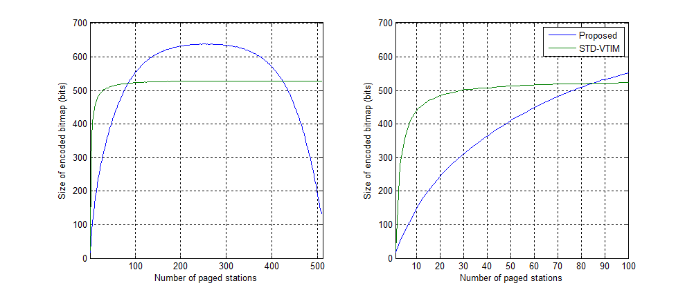
Results - Scenario 3
Nasta = 512
The proposed encoding is better for Npsta <85 (bitmap density < 17%)
Up to 80% better encoding (Npsta<85)
Not likely to have >100 STAs be paged in a single TIM

Slide 30
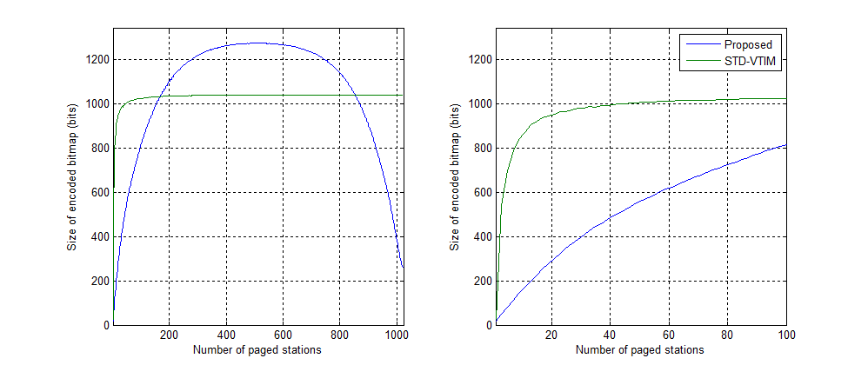
Results - Scenario 4
Nasta=1024
The proposed encoding is better for Npsta <165 (bitmap density<17%)
Up to 90% better encoding (Npsta<165)
Not likely to have >100 STAs be paged in a single TIM

Slide 31
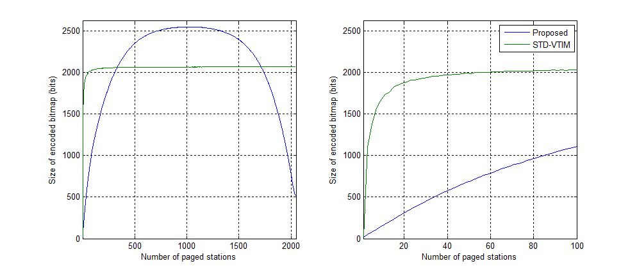
Results - Scenario 5
Nasta = 2048
The proposed encoding is better for Npsta <330 (bitmap density<16%)
Up to 95% better encoding (Npsta<330)
Not likely to have >100 STAs be paged in a single TIM

Slide 32
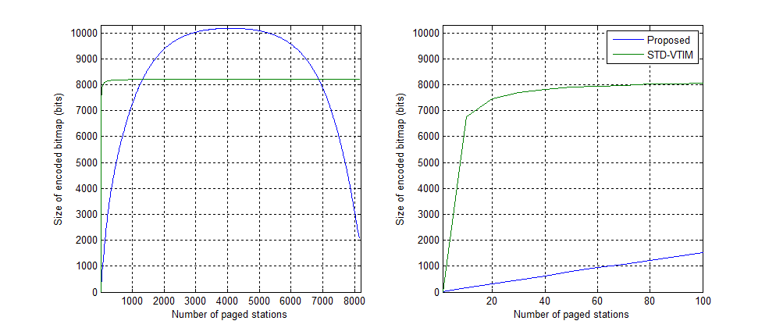
Results - Scenario 6
Nasta = 8192
The proposed encoding is better for Npsta <1300 (bitmap density < 16%)
Up to 98% better encoding (Npsta<1300)
Not likely to have >100 STAs be paged in a single TIM

