Slide 1
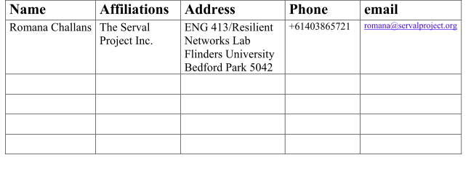
Issues with Adhoc Mode in Mesh Networking
November 2011
doc.: IEEE 802.11-11/1492r1
Date: 2011-11-06
Authors:
Submission
Slide
Romana Challans, The Serval Project Inc.

Slide 2
The Changing Face of Adhoc
November 2011
doc.: IEEE 802.11-11/1492r1
“Due to their short duration, small size, and focused purpose, IBSSs are sometimes referred to as ad hoc BSSs or ad hoc networks.” (p40, 802.11 Wireless Networks: The Definitive Guide, Second Edition)
Ad hoc wireless networking inherited a great deal from Ethernet wired networking concepts and standards, however, increasingly sophisticated network models are becoming conceived, and serious attempts to implement them are being hampered by the limitations inherited on ad hoc by previous expectations, poor hardware implementation, and the increasingly rapidly changing needs of a mobile society.
Submission
Slide
Romana Challans, The Serval Project Inc.

Slide 3
Adhoc Mesh Networking Scenarios
November 2011
doc.: IEEE 802.11-11/1492r1
Small area, limited nodes (<50) eg Gaming LANs, some environmental monitoring projects
Large area, limited nodes (<200) eg Remote and rural connectivity, some environmental monitoring projects
Small area, large amount of nodes (>1000) eg emergencies, mass gatherings, industries such as some mining operations
Large area, large amount of nodes (>1000) eg emergencies, disasters, mass gatherings
Submission
Slide
Romana Challans, The Serval Project Inc.
.

Slide 4
Current Issues Facing Widespread Adoption of Adhoc Wireless Mesh Networks
November 2011
doc.: IEEE 802.11-11/1492r1
BSSID/ Cell ID Cell splitting - to avoid the issue, avoiding or even breaking the standard is required.
Beaconing - the greedy function that reduces efficiency and steals bandwidth.
Information - access to documentation and information in the community - can we play a stronger part in the process of development and research?
Submission
Slide
Romana Challans, The Serval Project Inc.

Slide 5
One bad apple spoils the bunch - BSSID/Cell ID Split
November 2011
doc.: IEEE 802.11-11/1492r1
If every node on the network had firmware (and sometimes, hardware), that was perfect world standard, made to the purest version of IEEE standards, then Cell Splits, as they are often called, would never happen. A long known bane of the Linux Wireless community, the sad reality is that such perfect world implementations just don’t happen.
The difficulty as a result is just ONE poorly implemented node can cause the ENTIRE Ad hoc network to fail. Just one.
Submission
Slide
Romana Challans, The Serval Project Inc.

Slide 6
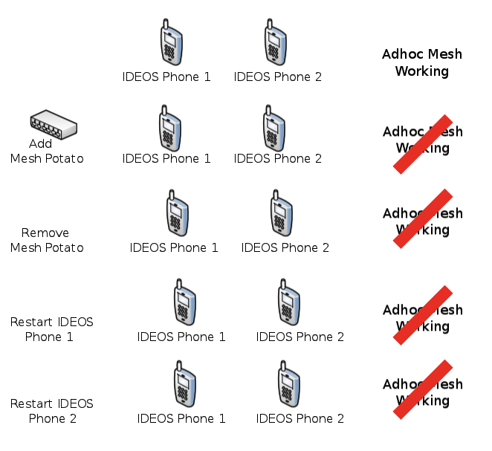
Use Case : One potato, two potat...erm, phones.
November 2011
doc.: IEEE 802.11-11/1492r1
Two IDEOS Phones form an Adhoc Mesh Network.
Add one Mesh Potato from Village Telco, and the network is broken.
Remove the Mesh Potato, the network remains broken.
Reboot IDEOS Phone 1 - same result.
Reboot IDEOS Phone 2 - same result.
It is not until the phones are rebooted that the network functions again.
Submission
Slide
Romana Challans, The Serval Project Inc.
Notes:
Some of the issues with Adhoc networking remains firmware implementation. It is a variable factor with manufacturers - there is no guarantee of all firmwares for all devices being made to the same standard,

Slide 7
Use Case : Village Telco
November 2011
doc.: IEEE 802.11-11/1492r1
“The ad-hoc mode has been widely neglected by chipset manufacturers and driver developers. Implementing ad-hoc mode is much more complicated than implementing station mode (accesspoint client).” (The phenomenon of IBSS-ID cell splits, Village Telco Wiki Article: Information about cell-id splitting, stuck beacons, and failed IBSS merges)
Village Telco found the problem was due to poor implementation of standards, and the only resolution for the problem was to bypass standards altogether, and manually fix the BSSID/Cell ID and “tricking the cards into not attempting to synchronize them”.
Submission
Slide
Romana Challans, The Serval Project Inc.
Notes:
Village Telco discovered the issues they were having with BSSID/Cell ID splitting was due to poor implementation of standards, meaning they had stuck beacons and race conditions triggered by MAC timer skews/attempted IBSS merges.

Slide 8
Beacons : Useful Chatterboxes
November 2011
doc.: IEEE 802.11-11/1492r1
As nodes are added to a mesh network, interference from beacons steadily increases. In areas of high node density, this becomes extremely problematic - and nodes end up receiving more faint interfering beacons than they do actual beacons*.
This reduces the amount of usable air-time, and greatly increases the probability of requiring retransmission of unicast packets and loss of broadcast packets, further reducing the effective available bandwidth on the channel.
Blue is Communication Range
Pink is Interference Range
* Moreover, at a rate of 10Hz each, the probability of receiving an slice of air time that is free of interference drops as the number of nearby nodes increases.
Submission
Slide
Romana Challans, The Serval Project Inc.

Slide 9
Unanswered questions
November 2011
doc.: IEEE 802.11-11/1492r1
As research and expanded usage of Ad hoc (and other) mesh networks continues, these points, among others will need to be addressed. Information can be difficult or unreliable (in the public domain).
These are issues such as :
Node capacity on Ad hoc networks in 802.11s and other protocols (limited documentation found has suggested restrictions with reliable node capacity to around 50 nodes).
Speed limitations on Mesh Networks (again, some documentation has suggested limitations of 11mbps - which, while sufficient in current terms, will rapidly become insufficient).
Submission
Slide
Romana Challans, The Serval Project Inc.

Slide 10
Potential solutions to issues raised
November 2011
doc.: IEEE 802.11-11/1492r1
Ignore BSSID - let software decide a solution
Set a BSSID - in Firmware, hash the text ESSID to create an iterative BSSID
Look at the solution provided in an older, (proprietary), simplified ad-hoc mode call ah-demo (sometimes pseudo-IBSS) mode. No timestamps, no merging, no race conditions, no beacons.
Monitoring for Beacon traffic - if large amount of beacon traffic detected, limit broadcast of beacons
Submission
Slide
Romana Challans, The Serval Project Inc.
Notes:
ah- mode I think it was introduced by the developers at Lucent. Also old cards with the Prism chipset and the Madwifi driver for Atheros supports it.

Slide 11
ServalProject.org
November 2011
doc.: IEEE 802.11-11/1492r1
Fully-distributed telephony, messaging and file-transfer for disaster, rural/remote and developing country use.
Also potential for mining and other industries with specialised communication needs
Large-scale ad-hoc mesh networks (but possibly only local direct reachability)
High-mobility of nodes
Protocols under continuous development
Using 802.11a/b/g/n as current transport, but not ideal, sub 1GhZ most promising prospect.
Submission
Slide
Romana Challans, The Serval Project Inc.

Slide 12
Mesh Networking & Standards
November 2011
doc.: IEEE 802.11-11/1492r1
I said this last time, and it bears repeating :
“Developers want to work using standards. Standards are a way to develop positively, with reliable and repeatable results. They are a sign of best practice engineering, and the best developers are always enthusiastic about such approaches.”
We don’t pretend to know all the answers, but we do know working with the IEEE will produce the best solutions.
Submission
Slide
Romana Challans, The Serval Project Inc.

Slide 13
References
November 2011
doc.: IEEE 802.11-11/1492r1
Dictionary.com, "ad hoc," in The Free On-line Dictionary of Computing. Source location: Denis Howe. http://dictionary.reference.com/browse/ad hoc.
About.com, "What is Ad-Hoc Mode in Wireless Networking?" Source location: Bradley Mitchell, About.com - http://compnetworking.about.com/cs/wirelessfaqs/f/adhocwireless.htm
802.11 Wireless Networks: The Definitive Guide, Second Edition. Source location: Matthew Gast, Publisher: O'Reilly Media Released: April 2005 - http://shop.oreilly.com/product/9780596100520.do
About.com, "Limitations of WiFi Ad Hoc Mode Networking" Source location: Bradley Mitchell, About.com - http://compnetworking.about.com/od/wirelessfaqs/f/adhoclimitation.htm
“Information about cell-id splitting, stuck beacons, and failed IBSS merges!” Source location: Village Telco Wiki - http://wiki.villagetelco.org/index.php?title=Information_about_cell-id_splitting%2C_stuck_beacons%2C_and_failed_IBSS_merges!
Submission
Slide
Romana Challans, The Serval Project Inc.

