Slide 1
DSA system for 2.4GHz ISM Band
Date: 2011-04-28
Authors:

Slide 2
Abstract
ISM band becomes more and more crowded
  because of many equipments with WLAN and Bluetooth systems.
DSA system is proposed as a solution to enhance the efficiency of spectrum use.
IG SRU (Spectrum Resource Usage) has been established to discuss this topic.

Slide 3
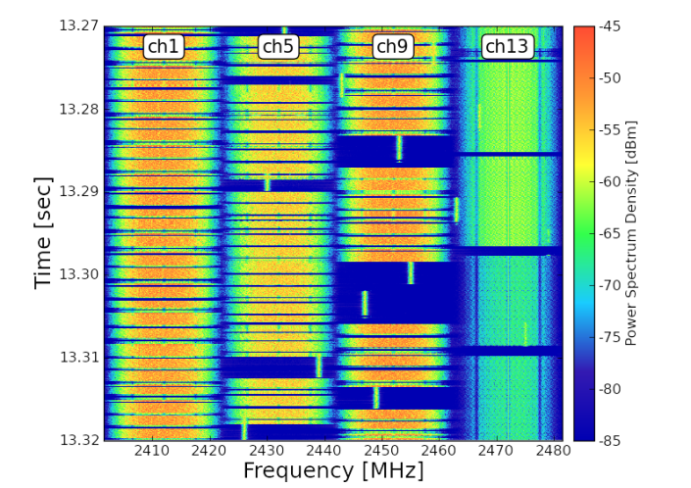
High traffic load situation in ISM band
- An assumption of future congestion -
Four BSSs (11b) at ch. 1, 5, 9, 13
One pair of Bluetooth
Allocation of equipment
Fragment unused spectrum resources still remain even if high-traffic load situation.
Using the fragment resources can enhance the efficiency of spectrum use.

Slide 4
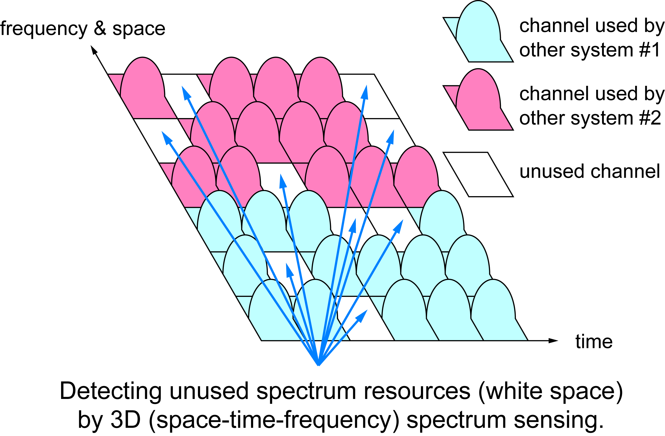
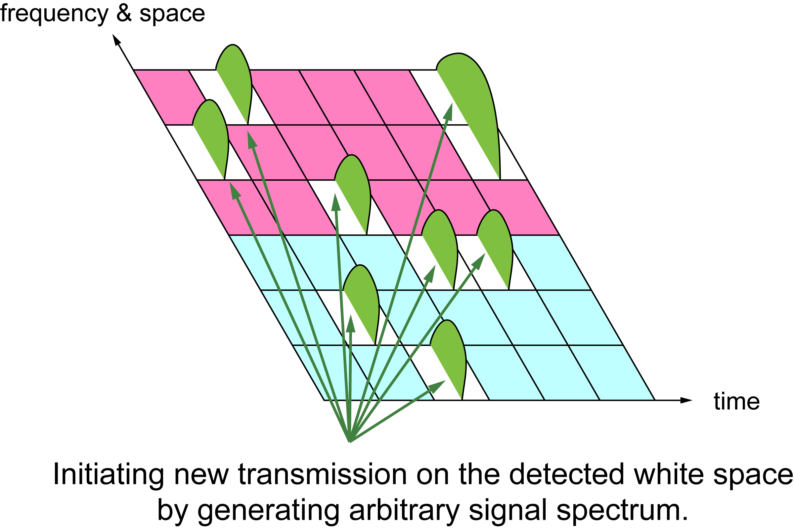
DSA system concept
DSA system transmits its own signals over fragmented unused radio resources detected by spectrum sensing.

Slide 5
Features of DSA system
Spectrum sensing
Signal assignment on fragmented unused frequencies
Frequency Time Division Multiple Access
Frequency hopping (FH) for Common Control Channel (CCH)

Slide 6
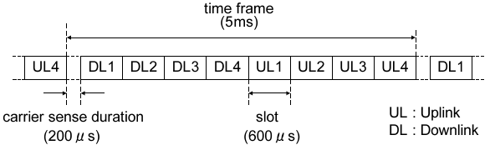
System overview
Frame structure
  8 slots for Down Link and Up Link in a frame
  200 μs-Spectrum sensing duration in each frame
Definition of channels
  Data Channel (DCH)
  Common Control Channel (CCH)
Sequence between AP and MS
  Spectrum sensing → Transmission
  CCH/DCH simultaneous transmission over different frequencies
AP
MS
spectrum sensing
DL CCH
DL DCH
UL DCH

Slide 7
Simulation
Throughput simulation of the DSA system with multiple wireless systems
By using PHY/MAC cross-layer simulator
Simulation settings
  10 m x 10 m area
  3 WLAN BSSs (1,5,9 ch)
    IEEE 802.11g ERP-OFDM DCF
  1 Bluetooth piconet (Not AFH)
  1 DSA (a pair of AP and MS)
  High load traffic condition
  Parameter: threshold of spectrum sensing
10m
10m
DSA
WLAN
Bluetooth

Slide 8
Simulation results
DSA system increases total throughput.
System total throughput gain
+1.2 Mbps | 10.7 %

Slide 9
Discussion in WG15
We presented this idea to WG15 WNG meeting in September 2010.
Interest group(IG SRU: Spectrum Resources Usage in WPANs) was started from November 2010.
  For discussing technologies of efficient spectrum use and their applications.
  Current discussion: measurement results of actual high traffic-load situation, DSA system concept and possible use cases
Next meeting will be held in July 2011.
  This group is open for discussion about better use of spectrum resources.

Slide 10
Plan of IG SRU
Goal: To make informative ideas to judge to establish SG.
Meeting Schedule: Every plenary meeting or on request.
IG life time: until March 2012.

Slide 11
Conclusions
In order to enhance the efficiency of spectrum use in 2.4GHz ISM band, we propose DSA system.
  Technical concept and simulation results are introduced.
The discussion of efficient spectrum use is on going IG SRU in WG15.
  Next meeting will be held July plenary meeting.
Let’s discuss about this topic together!

Slide 12
Reference
15-10-0739r1 A Proposal toward Better Use of Spectrum Resources in future WPAN
15-10-0886r0 Experimental results of High traffic-load situation
15-11-0161r0 System concept of DSA

