Slide 1
carrier-grade 802.11 operating in paired spectrum
Date: 2010-05-18
Authors:

Slide 2
introduction
previously, we described desire for Frequency Division Multiplex (FDM) in 802.11 [ref: 11-10-0287-03]
  for operation in paired spectrum, or TVWS
we presented at WNG because the idea seems long term and of broader interest
  with FDM, new (licensed) spectrum becomes available
  regulators often allocate different downlink and uplink spectrum
here, we illustrate candidate spectrum, and discuss pros and cons of FDM for 802.11
  we share evaluation results and collect feedback

Slide 3
outline
summary of 11-10-0287-03
scenarios in which 802.11 FDM may be beneficial
  802.11 FDM in TVWS
  802.11 in LTE paired spectrum
pros and cons of various approaches for FDM
  feedback channel & collision detection
  reserve capacity to the access point
conclusion and outlook

Slide 4
a modification of 802.11 was discussed in 11-10-0287-03
objective: to connect wireless devices in theme parks
  including toys & consumer products (hence chosing 802.11)
  with full coverage, carrier-grade quality, at low-cost
802.11 is our natural choice, but still has shortcomings
  larger number of APs is difficult to install in theme parks
  low-frequency TVWS regulation is complex: not enough channels available
we argued that modifying 802.11 towards FDM enables a new type of 802.11 that meets our needs
  FDM enables paired spectrum operation with uplink / downlink separation
  any paired spectrum, e.g., much of licensed LTE / WiMAX becomes available
  also beneficial for TVWS secondary spectrum usage
  larger 802.11 cell sizes and cellular-like network deployment become feasible

Slide 5
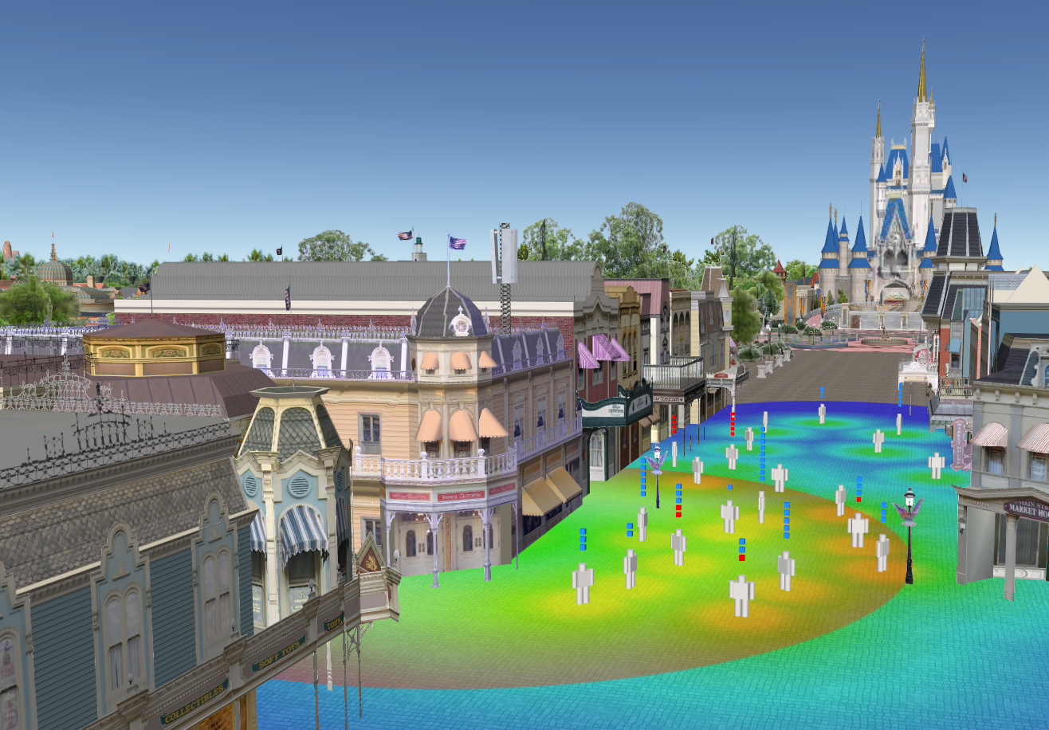
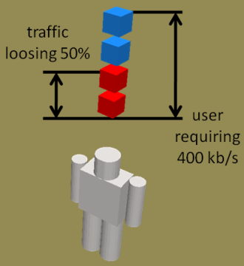
  carrier-grade 802.11 deployment area
outdoor coverage in theme park
unwanted
antennas
indicator for quality per user
large number of devices in hotspot
This is jemula802.

Slide 6
frequency division multiplex

Slide 7
  802.11 FDM in TVWS - regulation
FCC regulation separates fixed and portable channels
  example: TV channel 14: downlink only, no uplink
rules for
portable (uplink)
rules for fixed (downlink)
example

Slide 8
  802.11 FDM in TVWS - Disneyworld
In Disneyworld, FDM helps TVWS operation
  example: use TV channel 9 for fixed/downlink and use TV channel 28 for portable/uplink (assuming no Part 74 devices around)
no channel usable for downlink and uplink together
TV channel 9 could be used for fixed (downlink)
TV channel 28 could be used for portable (uplink)

Slide 9
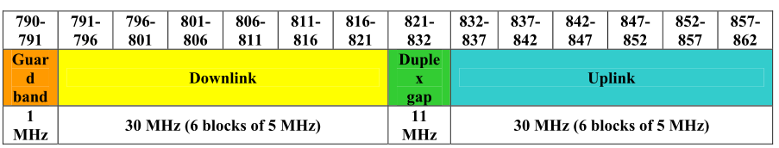
  802.11 in LTE paired spectrum
preferred harmonized frequency arrangement for the band 790-862 MHz [ref: CEPT (2009)]
other LTE bands:
  1.8 GHz, 2 GHz, 2.6 GHz mainly paired spectrum
  “technology neutral“ regulation: there is no reason for regulators to mandate a standard → 802.11 might as well be deployed

Slide 10
pros and cons of various FDM flavors
half duplex vs. full duplex
single radio vs. dual radio
required standard modifications

Slide 11
feedback channel & collision detection

Slide 12
performance analysis
with modified analytics of [ref: BIANCHI, G. (2000)
  actual results depend on TXOP duration (frame body length) versus duration of collision detection
  802.11 with ACK 802.11 FDM with collision detection

Slide 13
802.11 FDM advantages
potentially more TVWS channels available for 802.11
802.11 could be deployed in any paired spectrum
  WiMAX, LTE, including 700 MHz
allows to reserve capacity to the access point
collision detection instead of collision avoidance

Slide 14
802.11 FDM disadvantages
careful evaluation is needed in the areas of
  complexity: similar to dual radio?
  power consumption: state-of-art sleep modes sufficient?
  backward compatibility: coexistence and interoperability feasible at what cost?

Slide 15
conclusion and outlook
modifying 802.11 towards FDM would require
  single transmitter for half duplex: dual channel CCA & NAV
  coordinated dual-radio for full duplex: dual channel CCA & NAV
  modified NAV rules, other
802.11 with FDM can be backward compatible
FDM is a step towards carrier-grade 802.11
  enables use of other spectrum
outlook
  verify and evaluate open questions about complexity, performance, backward compatibility

Slide 16
references
MANGOLD, S. AND AIELLO, R. (2010a) Towards carrier-grade 802.11 at Disney theme parks. IEEE 802.11 working document, March 2010. 11-10-0287-03.
BIANCHI, G. (2000) Performance Analysis of the IEEE 802.11 Distributed Coordination Function. IEEE Journal of Selected Areas in Communications, 18 (3), 535-547.
CEPT (2009) Technical considerations regarding harmonization options for the digital dividend in the European Union – Frequency (channeling) arrangements for the 790-862 MHz band” . Final Report 31 by ECC within CEPT. Oct. 2009.

Slide 17
thank you for your attention! www.disneyresearch.com

